Slide 1


Slide 2




Slide 3



BINARY
TREE APPLICATION

Slide 4
PARSE TREE
What is parsing?
Originally from language study
The breaking up of sentences into component parts e.g. noun phrase
In computing compilers and interpreters parse programming languages
One aspect is parsing expressions

Slide 5
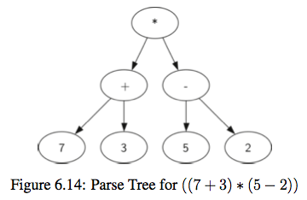
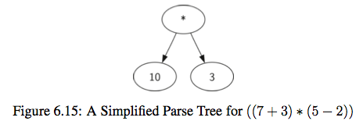
EXPRESSION TREE
The leaves are values and the other nodes are operators
We can use them to represent and evaluate the expression
We work up from the bottom evaluating subtrees
Compilers can use this to generate efficient code - e.g. how many registers are needed to calculate this expression

Slide 6
TOKEN
Parsing starts with recognising tokens
A token is a symbol made up of one or more characters (commonly separated by white space)
e.g. a variable name or a number or an operator “+”
For an expression tree the tokens are numbers, operators and parentheses

Slide 7
PARSING RULES
As we identify tokens we can apply rules to what we should do
If the expression is fully parenthesised
A left parenthesis “(“ starts a subtree
A right parenthesis “)” finishes a subtree

Slide 8
4 RULES
If the current token is a ‘(’, add a new node as the left child of the current node, and descend to the left child
If the current token is in the list [‘+’,’−’,’*’,‘/’], set the root value of the current node to the operator represented by the current token. Add a new node as the right child of the current node and descend to the right child
If the current token is a number, set the root value of the current node to the number and return to the parent
If the current token is a ‘)’, go to the parent of the current node

Slide 9
PARSING A TREE
(3 + (4 * 5))
Current node

Slide 10
(3 + (4 * 5))
PARSING A TREE
Current node

Slide 11
(3 + (4 * 5))
PARSING A TREE
Current node
3

Slide 12
(3 + (4 * 5))
PARSING A TREE
+
3
Current node

Slide 13
(3 + (4 * 5))
PARSING A TREE
+
3
Current node

Slide 14
(3 + (4 * 5))
PARSING A TREE
+
3
Current node
4

Slide 15
(3 + (4 * 5))
PARSING A TREE
+
3
*
4

Slide 16
(3 + (4 * 5))
PARSING A TREE
+
3
*
Current node
4
5

Slide 17
(3 + (4 * 5))
PARSING A TREE
+
Current node
3
*
4
5

Slide 18
(3 + (4 * 5))
PARSING A TREE
+
3
*
4
5

Slide 19
PARSING A TREE
Generate the expression tree for
((2 * ((3 - 4) + 6)) + 2)

Slide 20
OPERATIONS ON BINARY TREE
Searching an existing node
Inserting a new node
Deleting an existing node
Traversing the tree

Slide 21
OPERATIONS ON BINARY TREE
Pre-order Traversal
Process the root node
2. Perform preorder traversal of left subtree
3. perform preorder traversal of right subtree
In-order Traversal
1.Perform Inorder traversal of left subtree
2.Process the root node
3.Perform Inorder traversal of right subtree

Slide 22
OPERATIONS ON BINARY TREE
Post-order Traversal
1.Perform Postorder traversal of left subtree
2.Perform Postorder traversal of right subtree
3.Process the root node

Slide 23
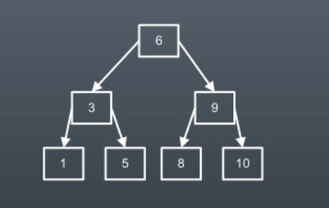
TREE TRAVERSAL
Inorder Traversal : 1 3 5 6 8 9 10
Preorder Traversal : 6 3 1 5 9 8 10
Postorder Traversal : 1 5 3 8 10 9 6

Slide 24
INSERTION ROUTINE
treeNode * Insert(treeNode * node, int data) { if (node == NULL) { treeNode * temp; temp = (treeNode * ) malloc(sizeof(treeNode)); temp - > data = data; temp - > left = temp - > right = NULL; return temp; } if (data > (node - > data)) | { node - > right = Insert(node - > right, data); } else if (data < (node - > data)) { node - > left = Insert(node - > left, data); } /* Else there is nothing to do as the data is already in the tree. */ return node; }

Slide 25
DELETION ROUTINE
treeNode * Delete(treeNode * node, int data) { treeNode * temp; if (node == NULL) { printf("Element Not Found"); } else if (data < node - > data) { node - > left = Delete(node - > left, data); } else if (data > node - > data) { node - > right = Delete(node - > right, data); } else { /* Now We can delete this node and replace with either minimum element in the right sub tree or maximum element in the left subtree */

Slide 26
DELETION ROUTINE contd….
if (node > right && node > left) { /* Here we will replace with minimum element in the right sub tree */ temp = FindMin(node - > right); node > data = temp > data; /* As we replaced it with some other node, we have to delete that node */ node > right = Delete(node > right, temp > data); } else { /* If there is only one or zero children then we can directly | remove it from the tree and connect its parent to its child */ temp = node; if (node - > left == NULL) node = node - > right; else if (node - > right == NULL) node = node > left; free(temp); /* temp is longer required */ } } return node; }

Slide 27
FIND MIN ROUTINE
treeNode * FindMin(treeNode * node) { if (node == NULL) { /* There is no element in the tree */ return NULL; } if (node > left) /* Go to the left sub tree to find the min element */ return FindMin(node - > left); else return node; }

Slide 28

THANK YOU

